Slide 1

Multi-Agency Risk Management Protocol

Slide 2
Training Objectives
Understand the MRM protocol
Understand layered approach and exclusions
Recognise escalation routes
Recognise multi-agency responsibilities

Slide 3
Why the Protocol Exists
Ownership of risk
Information sharing
Escalation pathways
Multi-agency decision making

Slide 4
What is MRM?
Multi-Agency Risk Management framework
Supports management of significant risk
Provides structured escalation route

Slide 5
Protocol Scope
Adults with mental capacity
Management of significant safeguarding risks
Multi-agency coordination

Slide 6
When MRM Should Not Be Used
Not a replacement for statutory safeguarding duties
Not a risk assessment tool
Not to be used when an adult does not have capacity (Follow best interest decision making)

Slide 7
Safeguarding Principles Overview
Empowerment
  Person-centered approach
Prevention
  Early intervention focus
Proportionality
  Balanced, informed response to risk
Protection
  Appropriate protective actions at all layers
Partnership
  Shared responsibility
Accountability
  Clear ownership and actions

Slide 8
Engagement With Adults
Maintain involvement wherever possible
Promote informed decision making
Use Making Safeguarding Personal (MSP) principles at all times
  Focus on individuals expected outcomes
  Learn about the person
  Understand what approaches will work, and why.
  Active engagement with the adult, family, carer and trusted friends

Slide 9
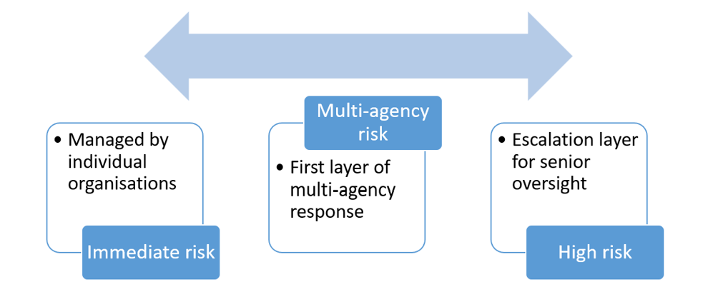
Layered Approach Overview
Immediate Risk
Multi-Agency Risk
High-Risk Escalation

Slide 10
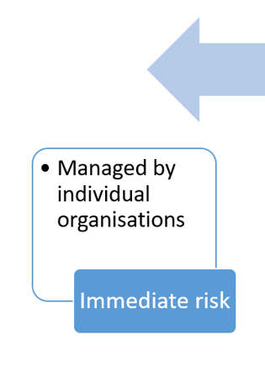
Immediate Risk Layer
Managed within agency arrangements
Monitor and review risks
Call 999 if adult is in immediate danger
Consider submission of Safeguarding concern*
Consider if shared multi-agency approach is required
* The referring agency maintains ownership of safeguarding risk.

Slide 11
Benefits of Multi-Agency Working
Shared understanding
Improved coordination
Increased adult information
Reduced duplication

Slide 12
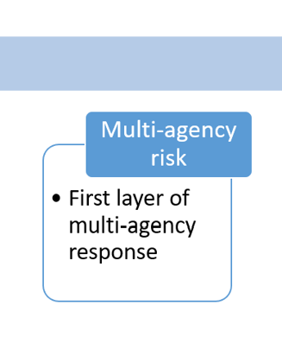
Multi-Agency Risk Layer
Multiple agencies involved
Identify risk
Defined lead agency and responsibility holder
Information sharing and joint action planning
Agree actions
Professional challenge
Involve adult, family, carer or trusted friend with decision making
Review outcomes

Slide 13
Who Can Convene an MRM?
Any agency can lead a multi-agency meeting
Lead agency coordination
  Coordinate meeting
  Document actions
  Arrange reviews
Arrange attendance and information sharing

Slide 14
Partner Agency Responsibilities
Attend and contribute
Provide information about the adult
Provide professional skills and experience
Provide professional challenge to decision making
Complete agreed actions

Slide 15
MRM Outcomes
Action plans informed by the adult and Professional knowledge
Review arrangements
Agree appropriate lead agency
Risk status
Escalation decisions

Slide 16
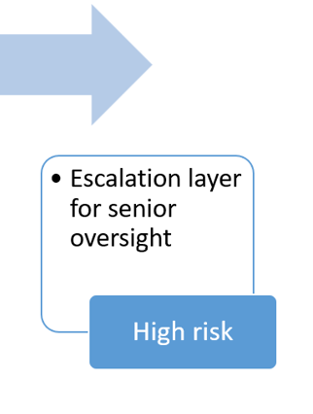
High-Risk Escalation Layer
Senior-level oversight for complex or persistent risk
Platform when professionals require support
Provide advice and guidance
Cases will not be held at escalation layer
Panel will be held every 2 months

Slide 17
When to Escalate
Persistent high risk
Capacity unclear despite reviewed assessments
Engagement unable to be established despite normal process followed
Appropriate policies & procedures not achieving expected outcomes
Unwise decision making
Escalation criteria met – use Checklist

Slide 18
Escalation Criteria
Severity of risk
Review effectiveness of previous interventions
Assessment of ongoing risk
Use check list as part of multi-agency meetings as a benchmark
Complete referral form if escalation required

Slide 19
Referral Process
Agree escalation required with multi-agency professional group
Complete referral documentation
Submit supporting information
Prepare discussion with panel

Slide 20
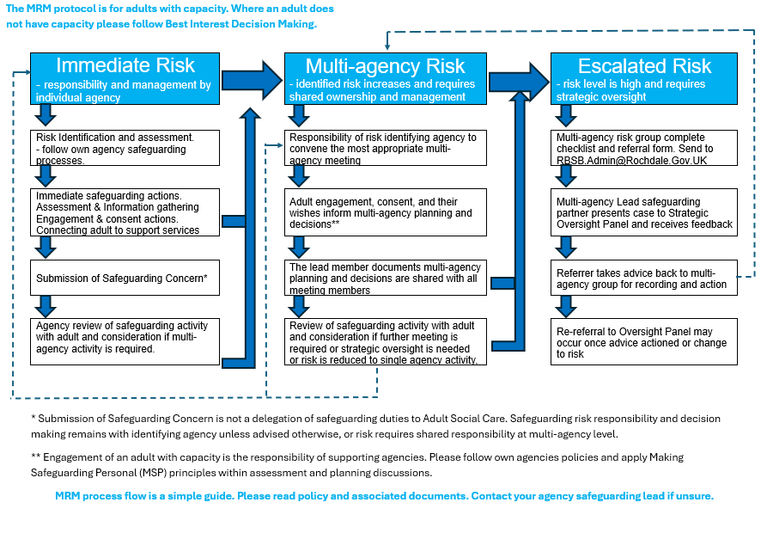
Process

Slide 21
Key Messages
Maintain risk ownership
Work collaboratively
Keep the adult central to decision making
Escalate when appropriate

Slide 22
Knowledge Check
Reflect on Protocol
Understand layered approach
Be aware of safeguarding responsibilities
Ensure you have read associated documents
Understand Capacity
Understand MSP principles

Slide 23
Questions
?

