Slide 1
Basic Introduction to Financial Abuse
Khalida Crossley
Tenancy Support Officer

Slide 2
Learning Outcomes
Understand the different types of financial abuse
Be able to recognise the signs of financial abuse
Understand the barriers to reporting financial abuse
Understand the implications of mental capacity and Making Safeguarding Personal
Know how to report a concern

Slide 3
What is Financial Abuse?
“The unauthorised and improper use of funds, property or any resources belonging to another individual”
(DH / Home Office, 2000)

Slide 4
Types of Financial Abuse
How many can you identify?

Slide 5
Types of Financial Abuse
Theft, fraud and exploitation
Pressure in connection with wills, property, inheritance or financial transactions
Misuse or misappropriation of property, assets, possessions, savings, capital or benefits
Theft i.e. money or possessions stolen, borrowed or withheld without permission

Slide 6
Types of Financial Abuse
Wrongfully controlling access to money or benefits
Preventing someone buying goods, services or leisure activities
Money being absorbed into a care home or household budget without the person’s consent
Being deliberately overcharged for goods or services, or being asked to part with money under false pretenses

Slide 7
Types of Financial Abuse
Deliberately overcharged for goods or services, or being asked to part with money under false pretenses
Not providing the care (1 to 1 and shared hours) but charging the client
Carrying out unnecessary work and / or overcharging
Postal, telephone and internet scams where the person has interacted with someone and has lost money.

Slide 8
Types of Financial Abuse
Unlicensed money lending (loan sharks) i.e. being offered a loan on very bad terms
Staff or volunteers borrowing money, or accepting gifts or money from clients
Misuse of a person’s assets by professionals
Altering ownership of property without consent.

Slide 9
Types of Financial Abuse
Exerting undue influence to give away assets.
Putting undue pressure on the person to accept lower-cost / lower quality services in order to preserve more financial resources to be passed to beneficiaries on death
Misuse of formal arrangement for finances: DWP Appointee, Lasting Power of Attorney and Court of Protection Deputy
Unauthorised use of a store reward card
Non-payment of personal allowance to a service user in a residential Home (to buy toiletries, pay for podiatrist or hairdresser)

Slide 10
Types of Financial Abuse
Misuse of bank debit card or post office card
Non-payment of social care fees
How many did you identify?

Slide 11
Prevalence
In Rochdale:
220 safeguarding referrals related to financial abuse as at least part of the abuse along with other categories.
Of these 115 were for only financial abuse out of a total of 702 (2017-2018 data).
They are often the hardest cases to prove.

Slide 12
Indicators/signs of Financial Abuse
How many can you identify?

Slide 13
What are the indicators?
Unexplained withdrawals from a person’s bank account
Cheque withdrawals to unknown businesses / persons
An unexplained shortage of money, despite an adequate income or immediately following benefit day
Unpaid or a sudden inability to pay bills
Payment of client contribution suddenly stops

Slide 14
What are the indicators?
Disparity between assets and satisfactory living conditions.
The person lacks belongings or services which they can clearly afford.
Reluctance on the part of family, friends or the person controlling funds to pay for replacement clothes or furniture.
Items purchased which are not appropriate for the person

Slide 15
What are the indicators?
Home improvements or repairs that are ‘out of character’ with the person’s lifestyle
Loans or credit being taken out by a person in circumstances that give cause for concern, such as the age of the person taking out the loan and the alleged reason for the loan
Pressure by family members and other people to sign over assets or alter wills
“Borrowing” money or items

Slide 16
Barriers to reporting
A survey conducted in Rochdale in August-September 2017 eliciting the views of the public revealed that:
57% of members of the public were confident that they would recognise financial abuse
66% would be confident in reporting financial abuse
Over 54% said they would be unwilling to report suspicions in case they were wrong

Slide 17
Barriers to reporting?
Factors which would make it more likely for concerns to be reported included:
Knowing where to report
Being a relative/friend of the victim
A telephone helpline
An email address that could be used to report
Being able to stay anonymous
Understanding what would happen as a result
Another common barrier is the fear of someone finding out you’ve made a report

Slide 18
What can we do about it
Ideas?
Notes:
Shout out ideas

Slide 19
What can we do about it
Be vigilant
Raise awareness – education
Professional curiosity – ask
Community involvement – looking out for neighbours
REPORT!

Slide 20
Support for those who lack capacity to manage their money
DWP Appointee
An appointee is a person who has been chosen by the Department of Work and Pensions (DWP) to receive and manage welfare benefits on behalf of someone.
A family member or a friend can act as an appointee.
The local authority can act too – there is an annual charge for this service

Slide 21
Support for those who lack capacity to manage their money
Lasting Power of Attorney (LPA)
An LPA is a legal document (created by the Mental Capacity Act 2005) that enables any individual over the age of 18 and who has mental capacity (the donor) to choose another individual or individuals (called attorney/s) to make decisions on their behalf.
There are two types of LPA:
A property and financial affairs LPA
A health and welfare LPA

Slide 22
What’s important
Joint working – involve the right people
Sharing information
Record keeping – document who you’ve told and when
Keep people safe – ensure their needs are met (e.g. a person paying a loan shark and consequently can’t afford to put the heating on)
If in doubt – involve safeguarding

Slide 23
Banking Protocol
The Banking Protocol is an initiative between the police, banking institutions & Trading Standards.
Its aims is to identify vulnerable victims who are in being defrauded of funds from their bank accounts and to intervene to prevent these crimes.
Victims, particularly elderly and other vulnerable people, are targeted for a range of fraud offences. These crimes often involve the perpetrator encouraging the victim to visit their bank or post office in person and withdraw or transfer cash. Often the perpetrator will accompany the victim in order to make the cash withdrawal or transfer.
If bank staff suspect a person is being coerced or the transaction is as a result of fraud, the transaction is highlighted and the Police are contacted.
The Protocol is designed to provide a standardised method for how these concerns are dealt with and reported to police.

Slide 24
Impact of Financial Abuse
Depression / anxiety / stress
Distress
Anger
Embarrassment / loss of self-esteem
Self-blame – decline in mental health
Denial / fear
Betrayal
Loss of confidence to live independently
Deterioration in physical health (leading to premature death)
Social isolation
More vulnerable to further exploitation
Inability to replace lost savings due to lack of earning potential
Risk of suicide

Slide 25
How to report
Contact Adult Care
Office hours 0300 303 8886
Out of office hours 0300 303 8875.
Email - AdultPreventionTeam@rochdale.gov.uk
If you think an adult is in immediate danger
contact the police on 999

Slide 26
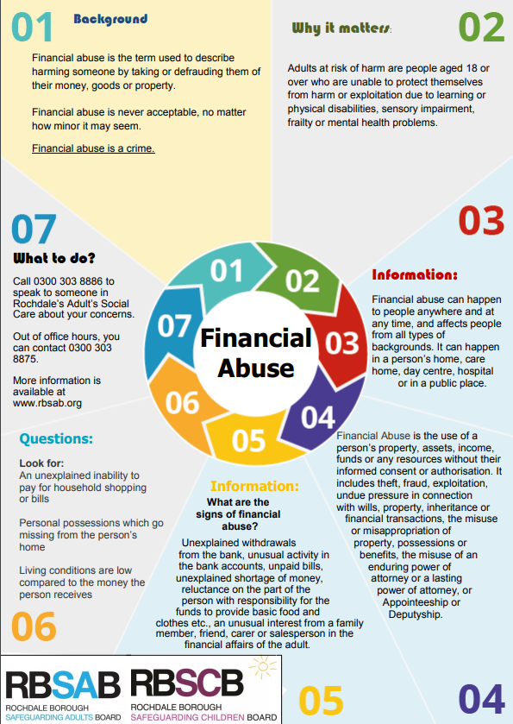
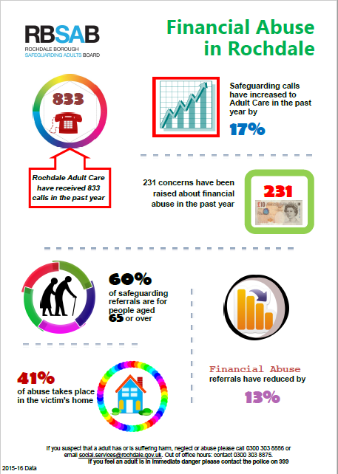
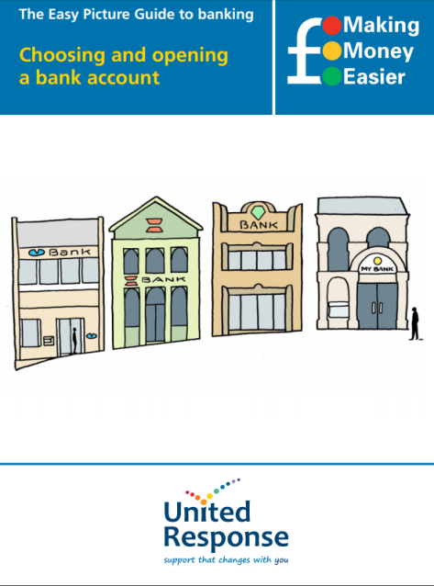
Resources available on the www.rbsab.org website

Slide 27
Thank you for taking part! We will email a link to the evaluation form. Once completed, we will send you your certificate of attendance.

